Slide 1

The Practice of Computing Using Python
Third Edition
Chapter 6
Files and
Exceptions I
Copyright © 2017, 2013, 2011 Pearson Education, Inc. All Rights Reserved
Notes:
If this PowerPoint presentation contains mathematical equations, you may need to check that your computer has the following installed:
1) MathType Plugin
2) Math Player (free versions available)
3) NVDA Reader (free versions available)

Slide 2
What is a File?
A file is a collection of data that is stored on secondary storage like a disk or a thumb drive
Accessing a file means establishing a connection between the file and the program and moving data between the two

Slide 3
Two Types of Files
Files come in two general types:
Text files. Files where control characters such as "/n" are translated. This are generally human readable
Binary files. All the information is taken directly without translation. Not readable and contains non-readable info.

Slide 4
File Objects or Stream
When opening a file, you create a file object or file stream that is a connection between the file information on disk and the program.
The stream contains a buffer of the information from the file, and provides the information to the program

Slide 5
Input-output Streams

Slide 6
Buffering
Reading from a disk is very slow. Thus the computer will read a lot of data from a file in the hopes that, if you need the data in the future, it will be buffered in the file object.
This means that the file object contains a copy of information from the file called a cache (pronounced “cash”)

Slide 7
Making a File Object
my_file = open(“my_file.txt”, “r”)
my_file is the file object. It contains the buffer of information. The open function creates the connection between the disk file and the file object. The first quoted string is the file name on disk, the second is the mode to open it (here, “r” means to read)

Slide 8
Where is the Disk File?
When opened, the name of the file can come in one of two forms:
“file.txt” assumes the file name is file.txt and it is located in the current program directory
“c:\bill\file.txt” is the fully qualified file name and includes the directory information

Slide 9
Different modes
Table 6.1 File modes.
Mode | How opened | File Exists | File Does Not Exist
‘r’ | read-only | Opens that file | Error
‘w’ | write-only | Clears the file contents | Creates and opens a new file
‘a’ | write-only | File contents left intact and new data appended at file’s end | Creates and opens a new file
‘r+’ | read and write | Reads and overwrites from the file’s beginning | Error
‘w+’ | read and write | Clears the file contents | Creates and opens a new file
‘a+’ | read and write | File contents left intact and read and write at file’s end | Creates and opens a new file

Slide 10
Careful with Write Modes
Be careful if you open a file with the ‘w’ mode. It sets an existing file’s contents to be empty, destroying any existing data.
The ‘a’ mode is nicer, allowing you to write to the end of an existing file without changing the existing contents

Slide 11
Text Files Use Strings
If you are interacting with text files (which is all we will do in this book), remember that everything is a string
Everything read is a string
If you write to a file, you can only write a string

Slide 12
Writing to a File
Once you have created a file object, opened for reading, you can use the print command
You add file=file to the print command

Slide 13
Close
When the program is finished with a file, we close the file
Flush the buffer contents from the computer to the file
Tear down the connection to the file
Close is a method of a file obj
file_obj.close()
All files should be closed!

Slide 14
Code Listing 6.1 : Reverse File Lines

Slide 15
Word Puzzle
The following listings show how one might solve the following puzzle: look through a file of words, one word per line, and identify any word that has all the vowels in order, with only one example of each vowel.
For example, “facetious”

Slide 16
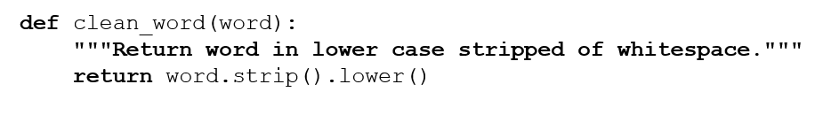
Code Listing 6.3 : clean_word

Slide 17
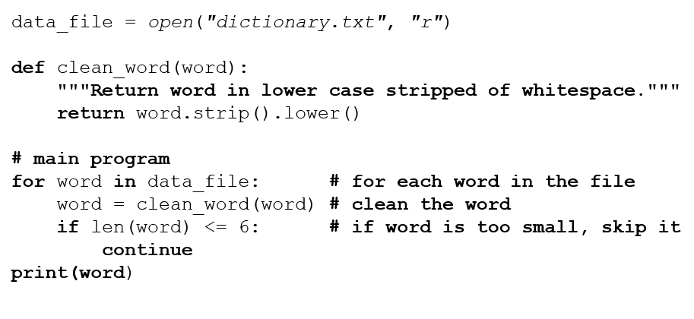
Code Listing 6.4

Slide 18
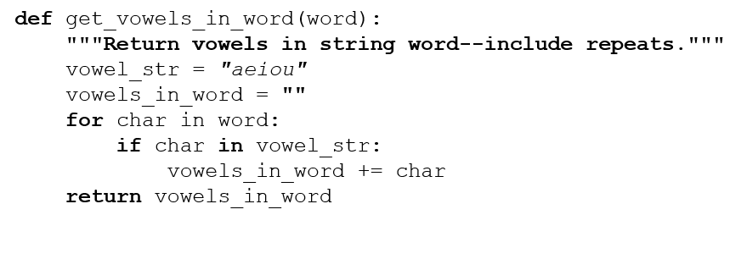
Code Listing 6.5 : get_vowels

Slide 19
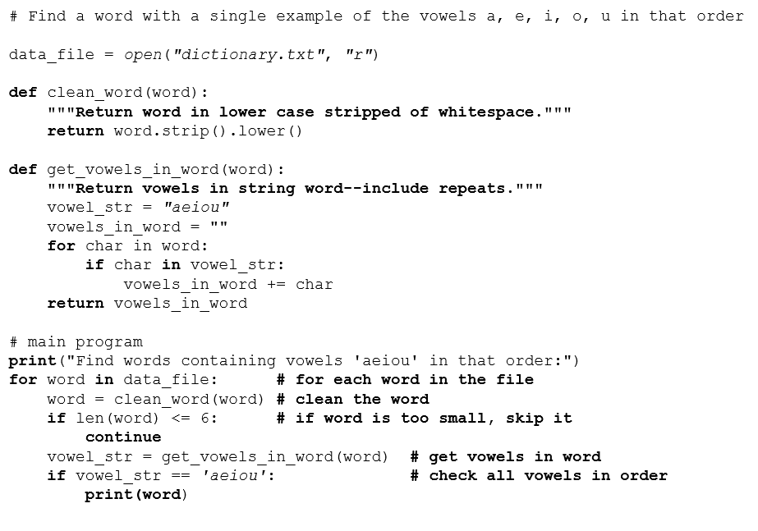
Code Listing 6.6 : Full Solution

Slide 20
Exceptions First Cut

Slide 21
How to Deal with Problems
Most modern languages provide methods to deal with ‘exceptional’ situations
Gives the programmer the option to keep the user from having the program stop without warning
Again, this is not about fundamental C S, but about doing a better job as a programmer

Slide 22
What Counts as Exceptional
Errors. Indexing past the end of a list, trying to open a nonexistent file, fetching a nonexistent key from a dictionary, etc.
Events. Search algorithm doesn’t find a value (not really an error), mail message arrives, queue event occurs

Slide 23
Exceptions (2)
Ending conditions. File should be closed at the end of processing, list should be sorted after being filled
Weird stuff. For rare events, keep from clogging your code with lots of if statements.

Slide 24
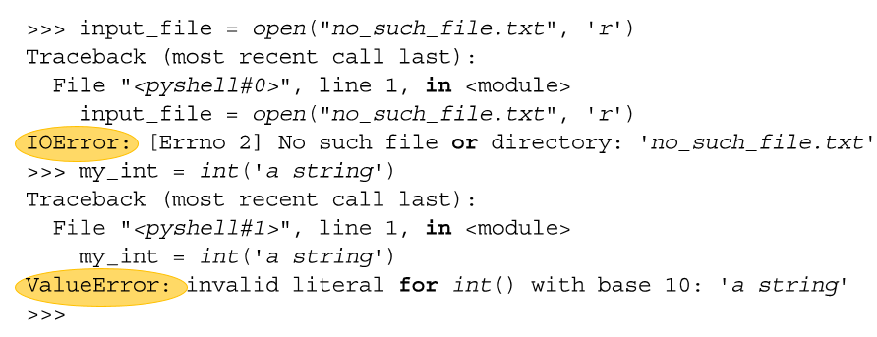
Error Names
Errors have specific names, and Python shows them to us all the time.
You can recreate an error to find the correct name. Spelling counts!

Slide 25
A Kind of Non-local Control
Basic idea:
Keep watch on a particular section of code
If we get an exception, raise/throw that exception (let it be known)
Look for a catcher that can handle that kind of exception
If found, handle it, otherwise let python handle it (which usually halts the program)

Slide 26
Doing Better with Input
In general, we have assumed that the input we receive is correct (from a file, from the user).
This is almost never true. There is always the chance that the input could be wrong
Our programs should be able to handle this.

Slide 27
Worse Yet, Input is Evil
"Writing Secure Code”, by Howard and LeBlanc
“All input is evil until proven otherwise”
Most security holes in programs are based on assumptions programmers make about input
Secure programs protect themselves from evil input

Slide 28
Rule 7
All input is evil, until proven otherwise

Slide 29
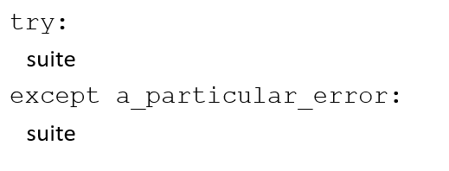
General Form, Version 1

Slide 30
try Suite
the try suite contains code that we want to monitor for errors during its execution.
if an error occurs anywhere in that try suite, Python looks for a handler that can deal with the error.
if no special handler exists, Python handles it, meaning the program halts and with an error message as we have seen so many times ☹

Slide 31
except Suite
An except suite (perhaps multiple except suites) is associated with a try suite.
Each exception names a type of exception it is monitoring for.
If the error that occurs in the try suite matches the type of exception, then that except suite is activated.

Slide 32
try/except Group
If no exception in the try suite, skip all the try/except to the next line of code
If an error occurs in a try suite, look for the right exception
If found, run that except suite and then skip past the try/except group to the next line of code
If no exception handling found, give the error to python

Slide 33
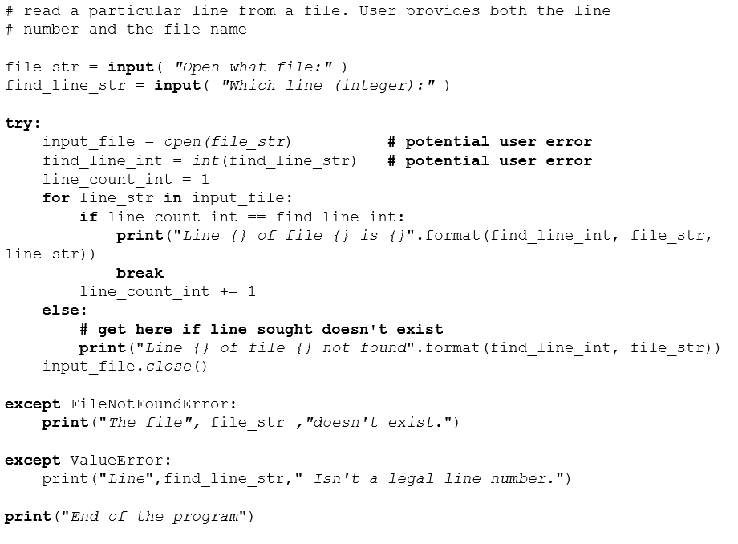
Code Listing 6.7 : Find a Line in a File

Slide 34
Counting Poker Hands

Slide 35
Reminder, Rules so Far (1 of 2)
Think before you program!
A program is a human-readable essay on problem solving that also happens to execute on a computer.
The best way to improve your programming and problem solving skills is to practice!
A foolish consistency is the hobgoblin of little minds
Test your code, often and thoroughly

Slide 36
Reminder, Rules so Far (2 of 2)
If it was hard to write, it is probably hard to read. Add a comment.
All input is evil, unless proven otherwise.

Slide 37
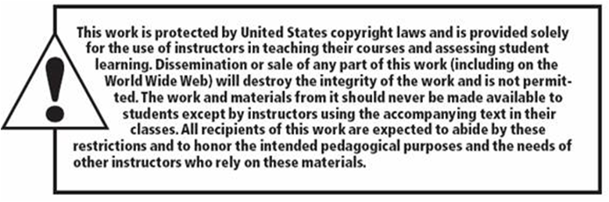
Copyright

